Slide 1

Text Document Summarization using Word Embedding Mudasir Mohd, Rafiya Janb and Muzaffar Shahc A weighted word embedding based approach for extractive text summarization Ruby Rani , Daya K. Lobiyal

Slide 2
Key Words
Summarization
Text summarization in NLP is the process of creating summaries from large volumes of data while maintaining significant informational elements and content value.
Extractive Summarization
involves extracting essential words from an original document and combining them to create a summary.
uses a scoring mechanism to rank the relevance of phrases to select just those that are most relevant to the source document's meaning.
Abstractive Summarization
Abstractive summarization concentrates on the most critical information in the original text and creates a new set of sentences for the summary.
The new sentence might not be a part of the source text.
This technique entails identifying key pieces, interpreting the context, and re-creating them in a new way.
It guarantees to give the most crucial information in the shortest possible words.

Slide 3
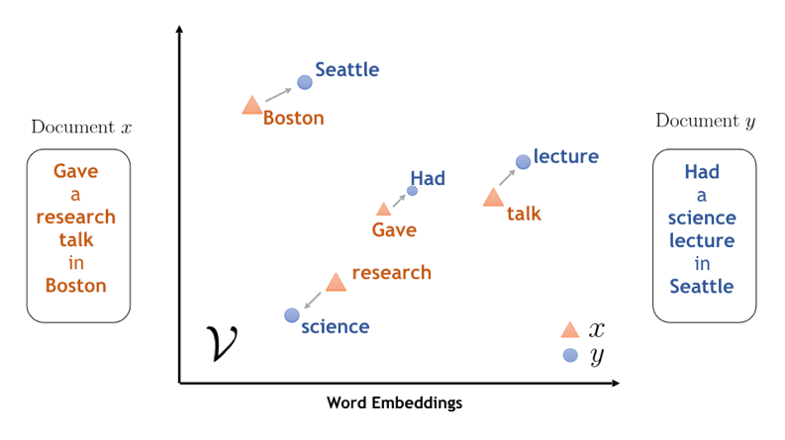
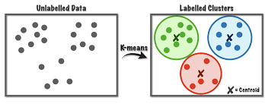
Key words
Word Embedding
(word2vec)
K-means clustering

Slide 4
Key words
ROUGE (Recall-Oriented Understudy for Gisting Evaluation)
is a set of metrics and a software package used for evaluating automatic summarization and machine translation software in natural language processing.
Cosine similarity
is a measure of similarity between two sequences of numbers
Big Vector Generation
concatenating respective top m similar words for each word
TF-IDF (Term Frequency-Inverse Document Frequency):
Identify the most important words in a textual document and thus the sentences.

Slide 5
The Need For Text Summarization
Text summarization shortens reading time.
Automatic summarization improves the effectiveness of searching.
The text summarization technique boosts the volume of data stored in a particular space.
Human summarizers are more biased and inaccurate than automatic summarizing techniques.
summaries are pivotal to the question-answering systems
summaries make selection of articles easier during researching

Slide 6
Preprocessing
Removing URL’s
Lower Case
Stop-word Removal
Tokenization
Lemmatization

Slide 7
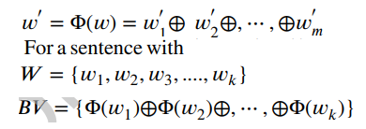
Capturing Semantics
Big-Vector Generation
Big-vector of a sentence is created by concatenating the similar words obtained from pre-trained Word2Vec model.

Slide 8
Clustering
pass these vectorized big-vectors as an input to the k-means clustering algorithm
Result:
clusters are formed based on the semantic similarity

Slide 9


Ranking Algorithm
Sentence Length
Sentence Position
Frequency (TF-IDF)
Identify the most important words in a textual document and thus the sentences.
The TF-IDF of the individual words and then uses the score of individual words to calculate the TF-IDF score of the sentences.

Slide 10
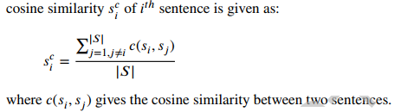
Ranking Algorithm (Count.)
Noun Phrase and Verb Phrase:
A sentence carrying noun and verb phrase is the most crucial sentence in the input text.
Proper Noun:
Proper nouns include direct references to the subject, and thus the presence of them in the sentence makes the sentence more important.
Aggregate Cosine Similarity:
Cosine similarity is used to compute the relatedness between two documents.

Slide 11
Ranking Algorithm (Count.)
Cue-Phrases:
Cue phrases are the connecting components between sentences; if a sentence has a cue-phrase in the beginning, it implies that itis dependent on the preceding sentence and thus this sentence should be included in the summary.
now, well, so, and, but, then, after all, furthermore, however, in consequence, as a matter of fact, in fact, actually, okay, alright, for example
Novel feature :
The words like moreover, however, because, etc., are called connecting words.
also removes redundancy

Slide 12
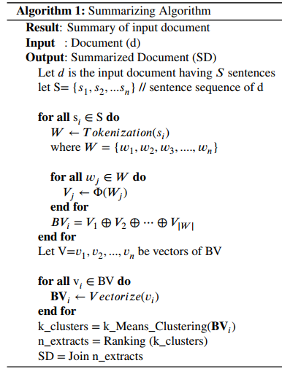
Algorithm

Slide 13
baselines
OPINOSIS :
is a graph-based summarization
Genism:
Text Rank algorithm
PKUSUMSUM:
is a Java summarization platform
PyTextRank:
is a graph-based summarization

Slide 14
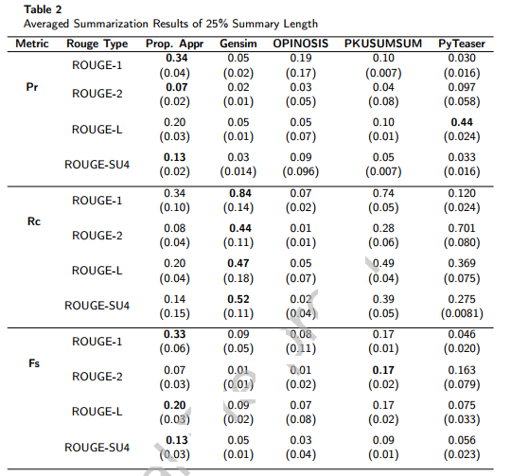
Result

Slide 15
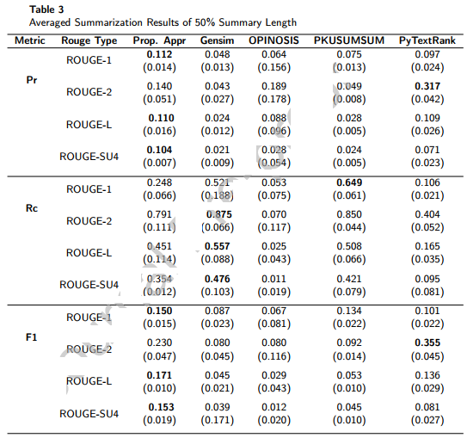
Result

Slide 16
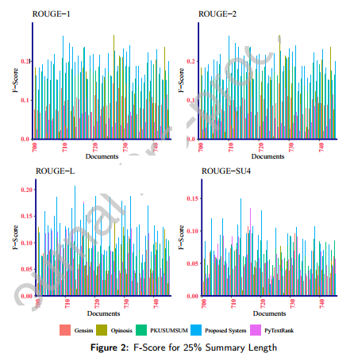
Result

Slide 17
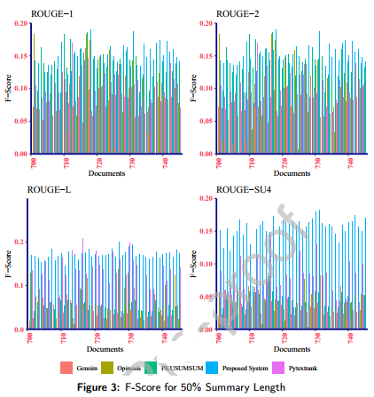
Result

Slide 18
SECOUND PAPER
A weighted word embedding based approach for extractive text summarization

Slide 19
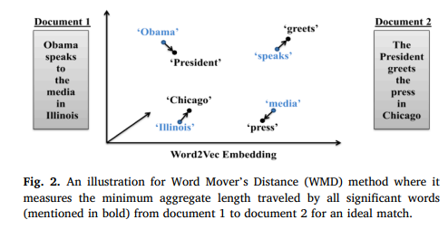
KEY WORD
Word Mover’s Distance(WMD)
measure the dissimilarity between two text documents.
learns the semantic meanings of words from local co-occurrences in sentences using Word2Vec .

Slide 20
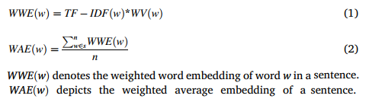
Data preprocessing
Sentence Segmentation
Weighted word vectors generation:

Slide 21

Data preprocessing (count.)
Feature extraction
Linguistic features:
Noun Phrase and Verb Phrase:
|s| represents the number of words in a sentence after preprocessing and #(x) represents the number of item x.
Proper Noun
Cue Phrases
Statistical features
Sentence Length: The number of words in a sentence after pre-processing is taken as the length of a sentence and denoted by |s|.
Sentence Position: Sentences exist in the beginning and at the end of the text document are more informative.

Slide 22
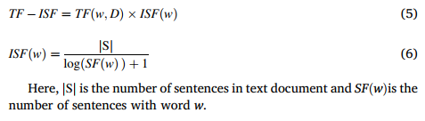
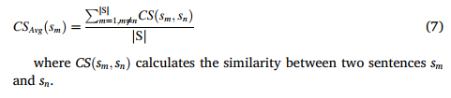
Data preprocessing (count.)
Term- Frequency-Inverse-Sentence-Frequency (TF-ISF): TF is the frequency of a word in the hole document. ISF is the number of sentences that carry the word.
Cosine Similarity: The cosine similarity method is used to measure the similarity between two text units.
Partitioning sentences using sentence embedding :
we apply the K-means text clustering algorithm to partition semantically closer sentences into the same cluster.
K-means algorithm , we feed average sentence embedding to the algorithm.
The main advantage of using average sentence embedding is that it captures the semantic dissimilarity between sentences.

Slide 23

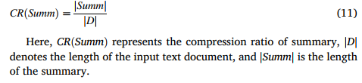
Data preprocessing (count.)
Sentence weighting and ranking algorithm (SWRA):
calculates the sentence weight for each sentence in the text document.
normalizes the sentence weight using its length.
sorts all sentences in decreasing order of their weights and selects the top ’t’ sentences from each cluster.
Summary generation Algorithm(SGA):
Redundancy Removal (RedR)
Diversity: the summary should include one sentence from the two sentences providing the same information but written in different forms.
Compression Ratio (CR)

Slide 24
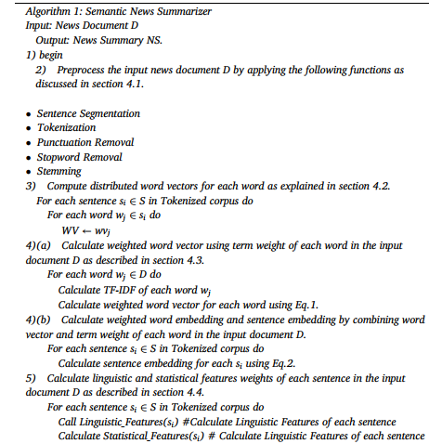
algorithm

Slide 25
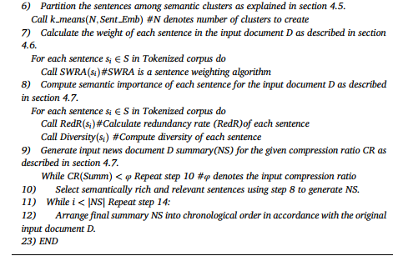
Algorithm (count.)

Slide 26
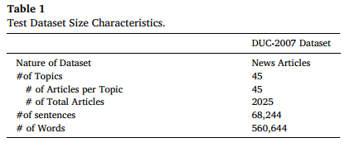
Baselines
Dataset : we use a benchmark dataset named the main task from Document Understanding Conference3 (DUC 2007) collected from the ACQUAINT corpus (National Institute of Standards and Technology (NIST)).
Mudasir’s model
TextRank
LSA
LexRank

Slide 27
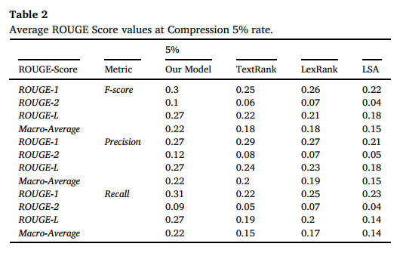
result

Slide 28
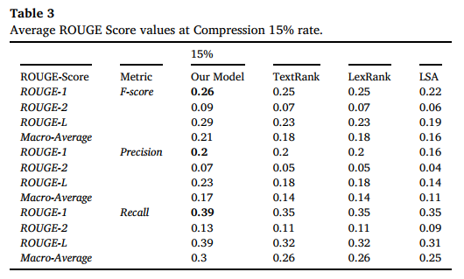
result

Slide 29
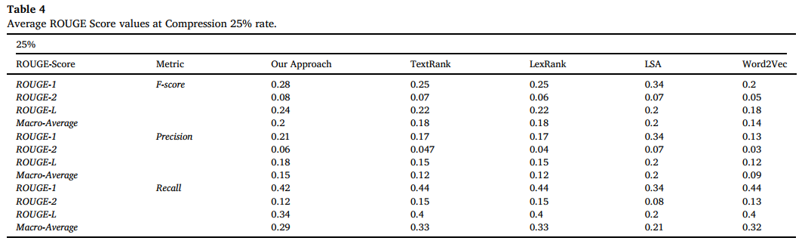
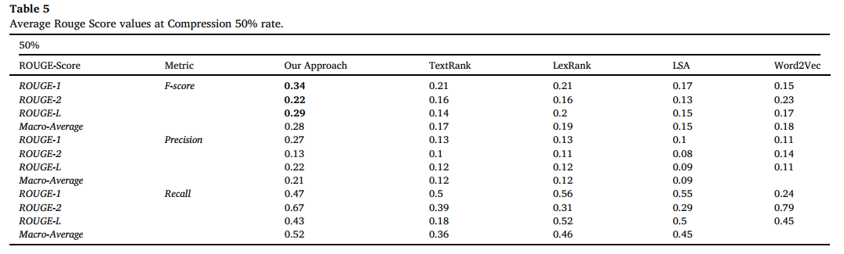

Slide 30
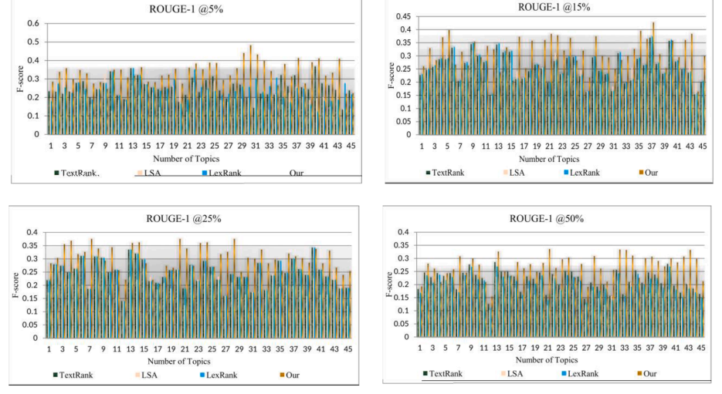
result

Slide 31
Thank you for your attention.

